Slide 1


Slide 2

Major Project-I (01CE0716)
Review 1 (12/07/2025)
Smart Blood Bank Management System
Team ID: 7CE_186
Team Member 1: MEET KALPESHBHAI PUJARA (92310103061) (7-TC1)
Team Member 2: KEVALYA DIPENBHAI SHETH (92310103068) (7-TC1)
Guided By
Prof. Priyanka Mangi
Department of Computer Engineering, Faculty of Engineering & Technology

Slide 3
Outline
Introduction
Abstract
Literature Review
Workflow process
Diagrams
Methodology
Tools and Technologies used
Probable User Interface
Project Scheduling (Gantt Chart)
Upcoming Tasks
Conclusion
References

Slide 4
Introduction
The Smart Blood Bank Donation Management System is a digital platform designed to modernize and streamline blood donation processes by efficiently connecting donors and blood bank organizations. This system eliminates manual inefficiencies, enhances donor engagement, and ensures optimal blood inventory management for lifesaving transfusions.
Core Entities:
Donors: Individuals who register to donate blood, track their donation history, and receive notifications for eligibility and upcoming drives.
Organizations: Blood banks, donation centers, and NGOs that manage blood collection, storage, and distribution.
Key Features:
Donor-Centric Approach: Easy registration, appointment scheduling, to encourage regular donations.
Inventory Optimization: Real-time tracking of blood stock levels by type, expiry dates, and demand trends.
Analytics & Reporting: Data-driven insights to improve donation rates, reduce shortages, and enhance operational efficiency.
By leveraging technology, this system ensures a transparent, responsive, and scalable blood donation ecosystem, ultimately improving the availability of safe blood for those in need.

Slide 5
Abstract
The Smart Blood Bank Donation Management System is an innovative digital platform designed to revolutionize blood donation processes by creating an efficient link between donors and blood bank organizations. This system addresses critical challenges in blood supply chain management, including donor recruitment, blood inventory tracking, and demand-supply coordination.
By leveraging modern technology, the platform provides donors with seamless registration, donation scheduling, and personalized reminders, while empowering blood banks and donation centers with real-time inventory monitoring, automated donor matching, and data-driven campaign management. Key features include a user-friendly interface, secure database management, intelligent analytics, and notification systems to optimize blood collection and distribution.
The system enhances transparency, reduces wastage, and ensures timely availability of blood, ultimately improving the efficiency of blood donation programs and saving more lives. This paper presents the architecture, functionalities, and benefits of implementing a smart, scalable, and donor-centric blood bank management solution.
Keywords: Blood Donation, Donor Management, Blood Bank System, Inventory Tracking, Digital Health Solution.

Slide 6
Literature Review
Digital Blood Bank Systems in Practice
Several countries have implemented technology-driven blood donation systems with measurable success:
India’s E-RaktKosh (2016):
A centralized web-based blood inventory management system launched by the Indian government.
Connects 4,000+ blood banks nationwide, reducing shortage-related deaths by 27% (Ministry of Health, 2020).
Uses barcoding to track blood units from donor to recipient.
2. South Africa’s SANBS Mobile App
The South African National Blood Service’s app sends real-time alerts to donors when their blood type is needed.
Increased repeat donations by 40% (SANBS Report, 2022).

Slide 7
Workflow
1. User (Donor/Recipient) Workflow
A. Registration & Login
Register:
User (donor/recipient) signs up via the website.
Provides personal details (name, contact, blood group, location,etc.).
Login: Authenticates via email/password.
B. Donor Management
View Donors:
Logged-in users can browse a list of registered donors.
Search & Filter Donors:
Search by blood group, location, or name.
System displays matching donors with contact details.
C. Request Blood:
User selects a donor and sends a blood request (email).
D. Contact for Queries:
Users can submit general queries through a contact form.

Slide 8
Workflow
2. Admin Workflow
A. Donor Management
View Donors: Admin sees a dashboard of all registered donors.
Manage Donors: Add, edit, or deactivate donor profiles.
Verify donor eligibility (approve/reject).
B. Blood Group & Inventory Management
Manage Blood Groups: Add/update blood group classifications (A+, B-, etc.).
Track Blood Inventory: View available blood units by type.
Update stock levels after donations/transfusions.
C. Website & Content Management
Edit Website Pages: Modify homepage, FAQs, donation guidelines.
Manage User Queries: View and respond to user-submitted questions.
D. General Admin Tasks:
Ban abusive users.
Backup database.
3. End-to-End Workflow Summary
For Users (Donors/Recipients): Register → Login → Search Donors → Request Blood → Contact for Help
For Admin: Login → Manage Donors → Manage Blood Groups → Update Inventory → Handle Queries → Edit Website

Slide 9
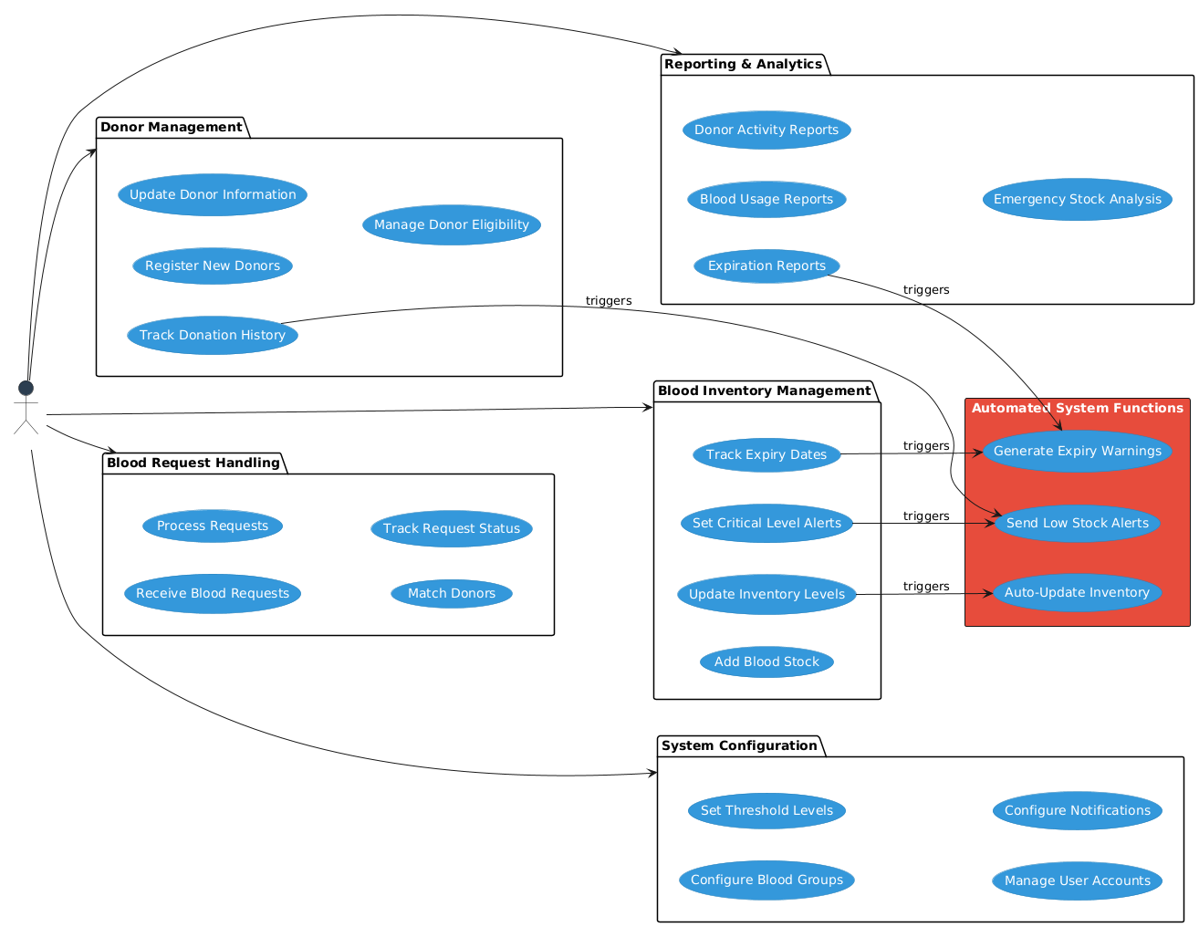
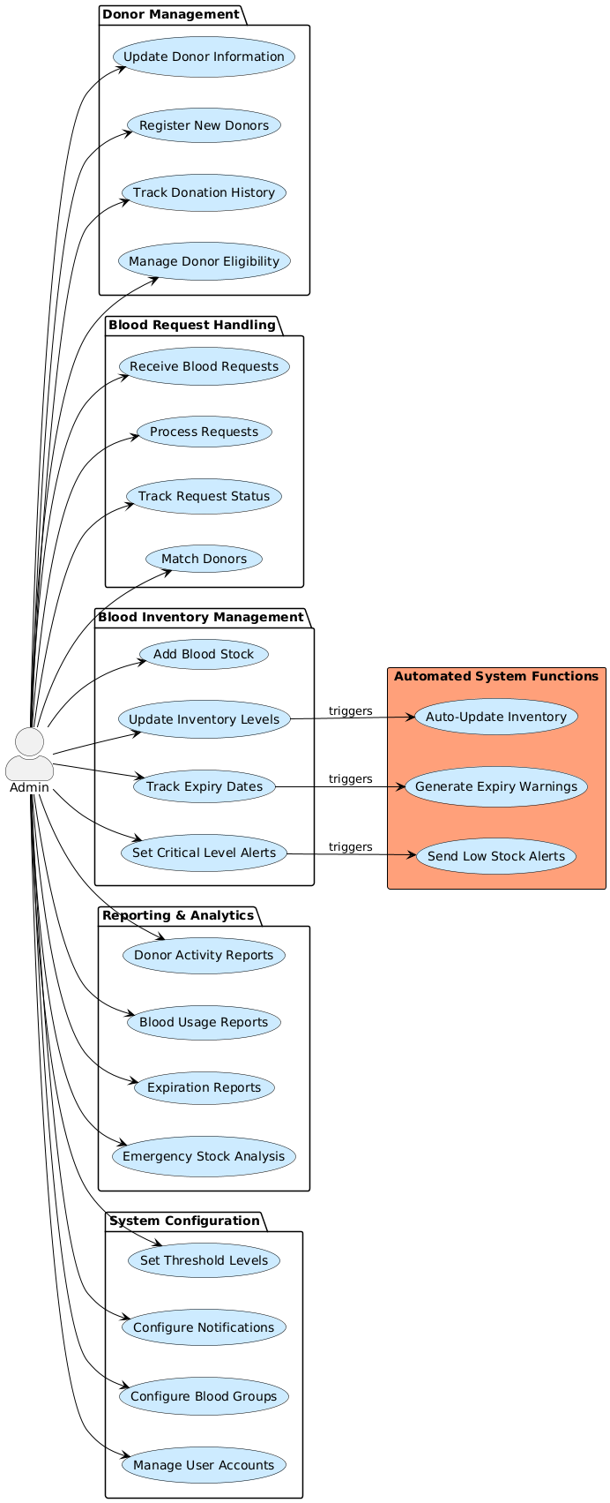
Use Case Diagram (Admin)

Slide 10
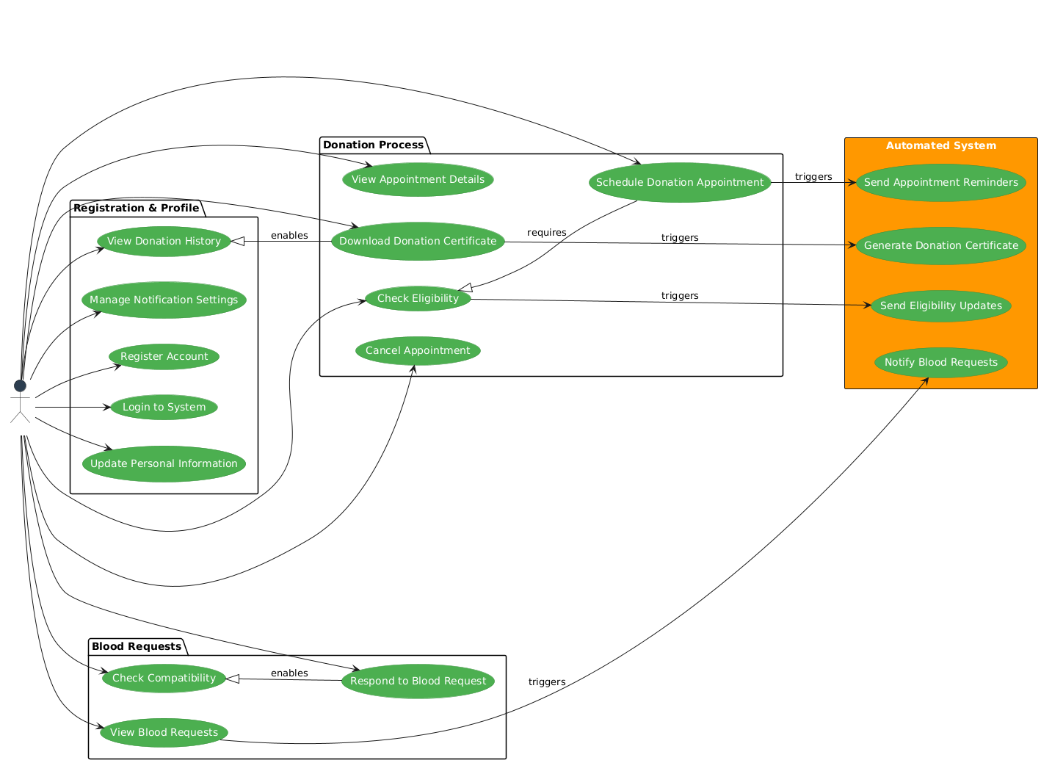
Use Case Diagram (Donor)

Slide 11
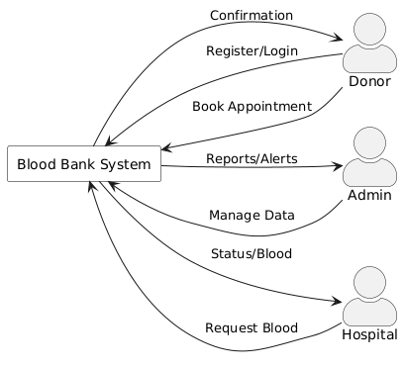
Data flow Diagram (Context Level)

Slide 12
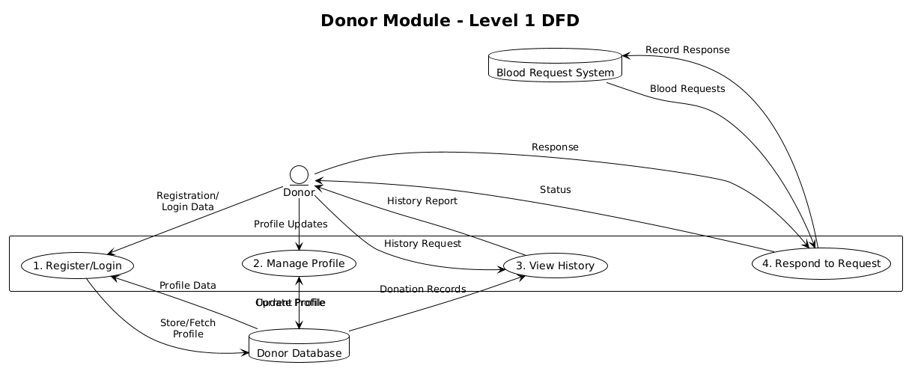
Data flow Diagram (Donor – Level 1)

Slide 13
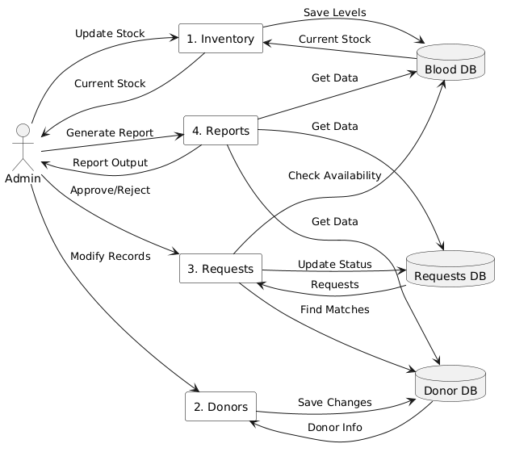
Data flow Diagram (Admin - Level 1)

Slide 14
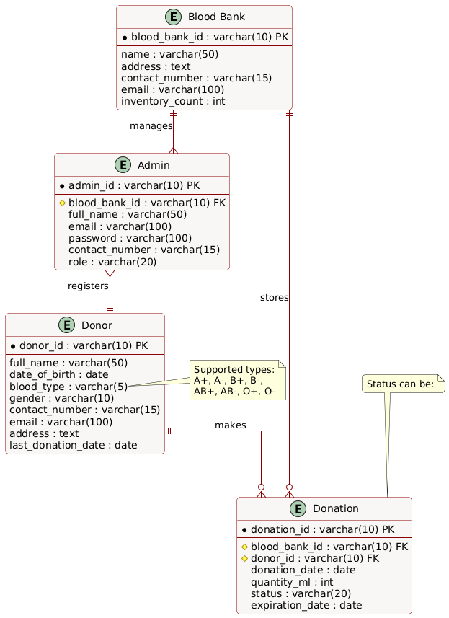
Entity Relationship Diagram

Slide 15
Methodology
Iterative Waterfall Approach
1. Methodology Overview
We'll implement an Iterative Waterfall Model with 4 iterations, focusing exclusively on the two core entities:
Donor Management
Blood Bank Organization Management
2. Phase Breakdown
Phase 1: Requirements Analysis (2 Weeks)
Focus: Core entity requirements
Donor Entity:
Registration
Profile management
View Requests
Blood Bank/Admin Entity:
Inventory management
Stock tracking
Expiry monitoring
Donor Management
Request Management
Site Monitoring

Slide 16
Methodology
Phase 2: System Design (3 Weeks)
Architecture:
Presentation Layer: PHP/HTML/CSS
Application Layer: PHP Business Logic
Data Layer: MySQL
Phase 3: Implementation (4 Weeks/Iteration)
Phase 4: Testing (2 Weeks/Iteration)
Phase 5: Deployment (1 Week/Iteration)

Slide 17
Tools & Technologies Used (Core Tech Stack)
Category | Technology | Purpose
Frontend | HTML5, CSS3, JavaScript | Basic web page structure and styling
 | Bootstrap 5 | Responsive UI components and layout
 | Chart.js | Data visualization for inventory analytics
 | Font Awesome | Icons for intuitive UI
Backend | PHP 8.1+ | Server-side scripting and logic
 | MySQL 8.0 | Relational database management
 | Apache 2.4 | Web server
Security | PHP Password Hashing | Secure password storage
 | Prepared Statements | SQL injection prevention
 | SSL/TLS | Encrypted data transmission
Core Technology Stack

Slide 18
Tools & Technologies Used (Testing, Design & VCS)
Version Control:
Git for source code management
GitHub for repository hosting and collaboration
2. Development Environment:
XAMPP (Windows) or MAMP (Mac) for local PHP/MySQL environment
VS Code with PHP Intelephense extension
3. Testing Tools:
PHPUnit for unit testing
Postman for API testing
BrowserStack for cross-browser testing
4. Design Tools:
Figma for UI/UX design and prototyping
Core Technology Stack

Slide 19
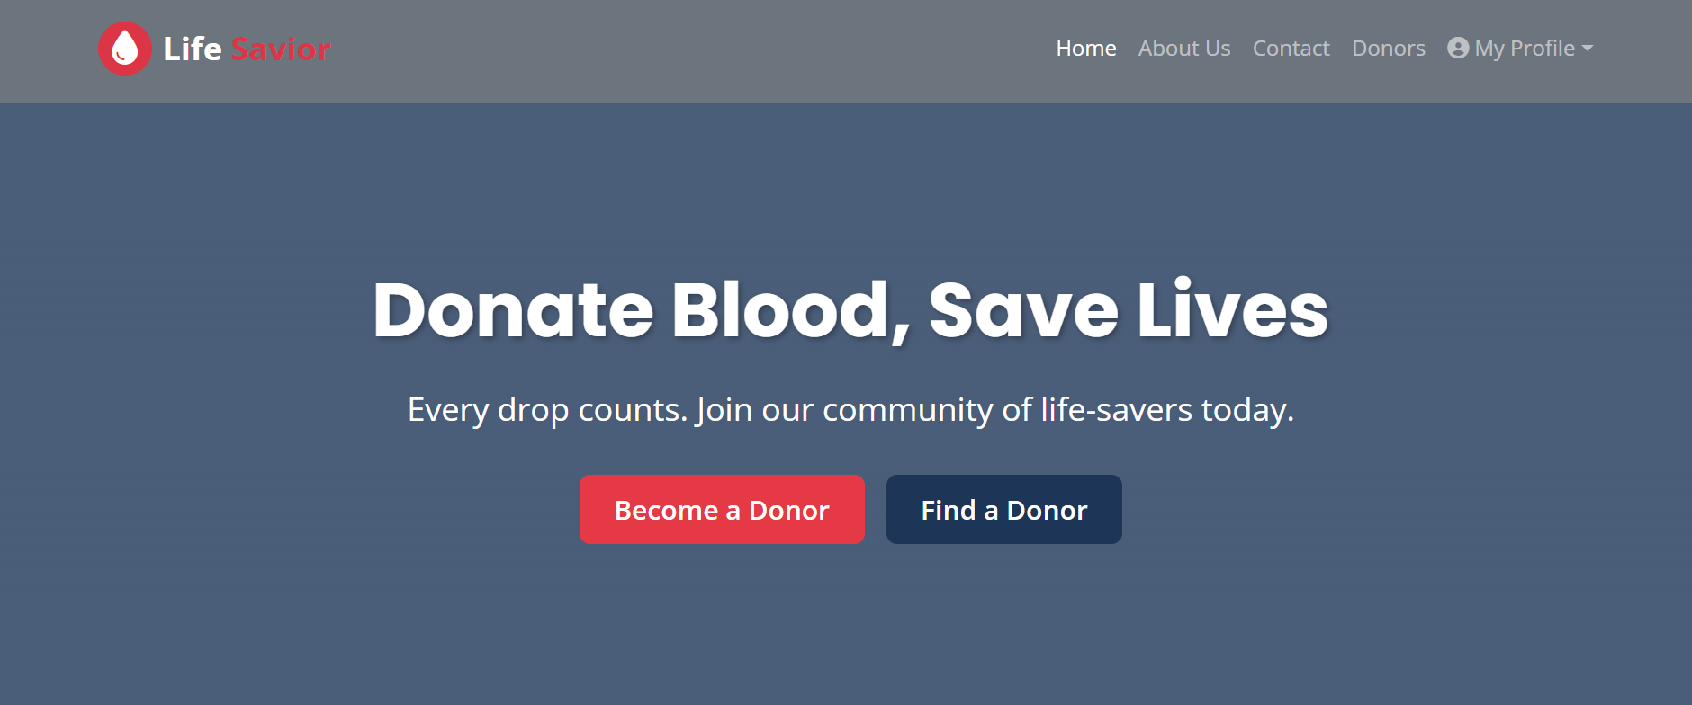
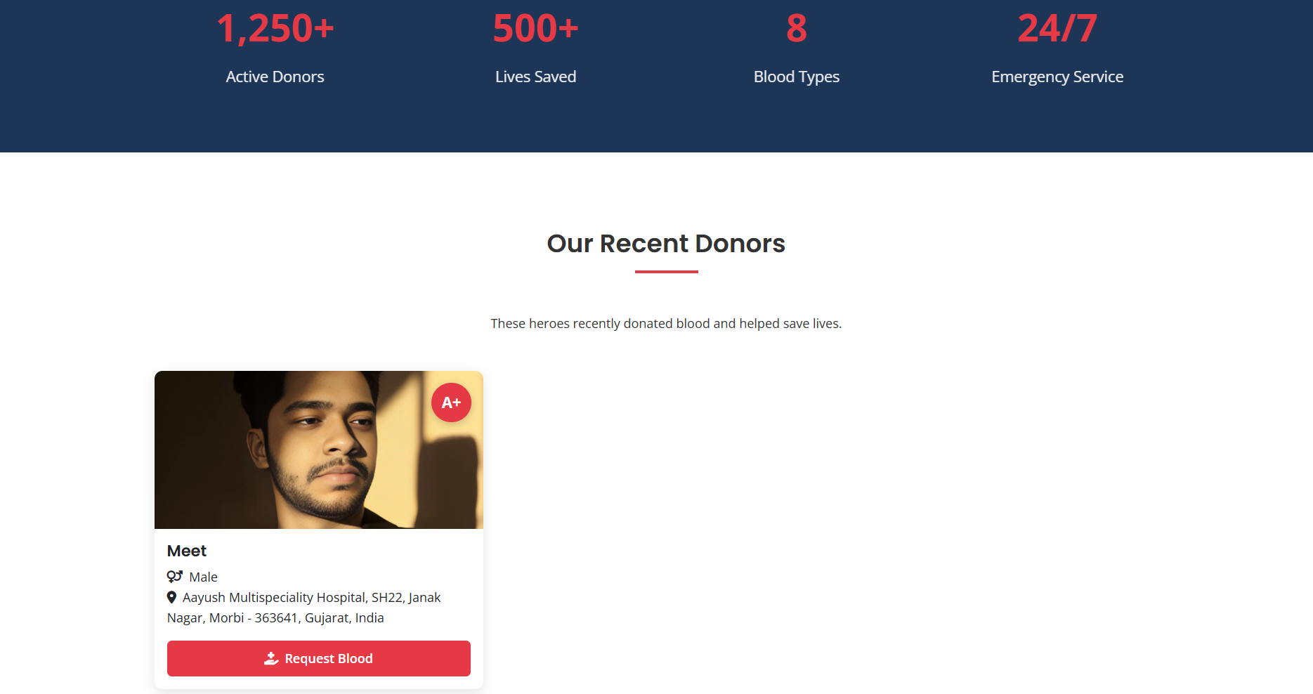
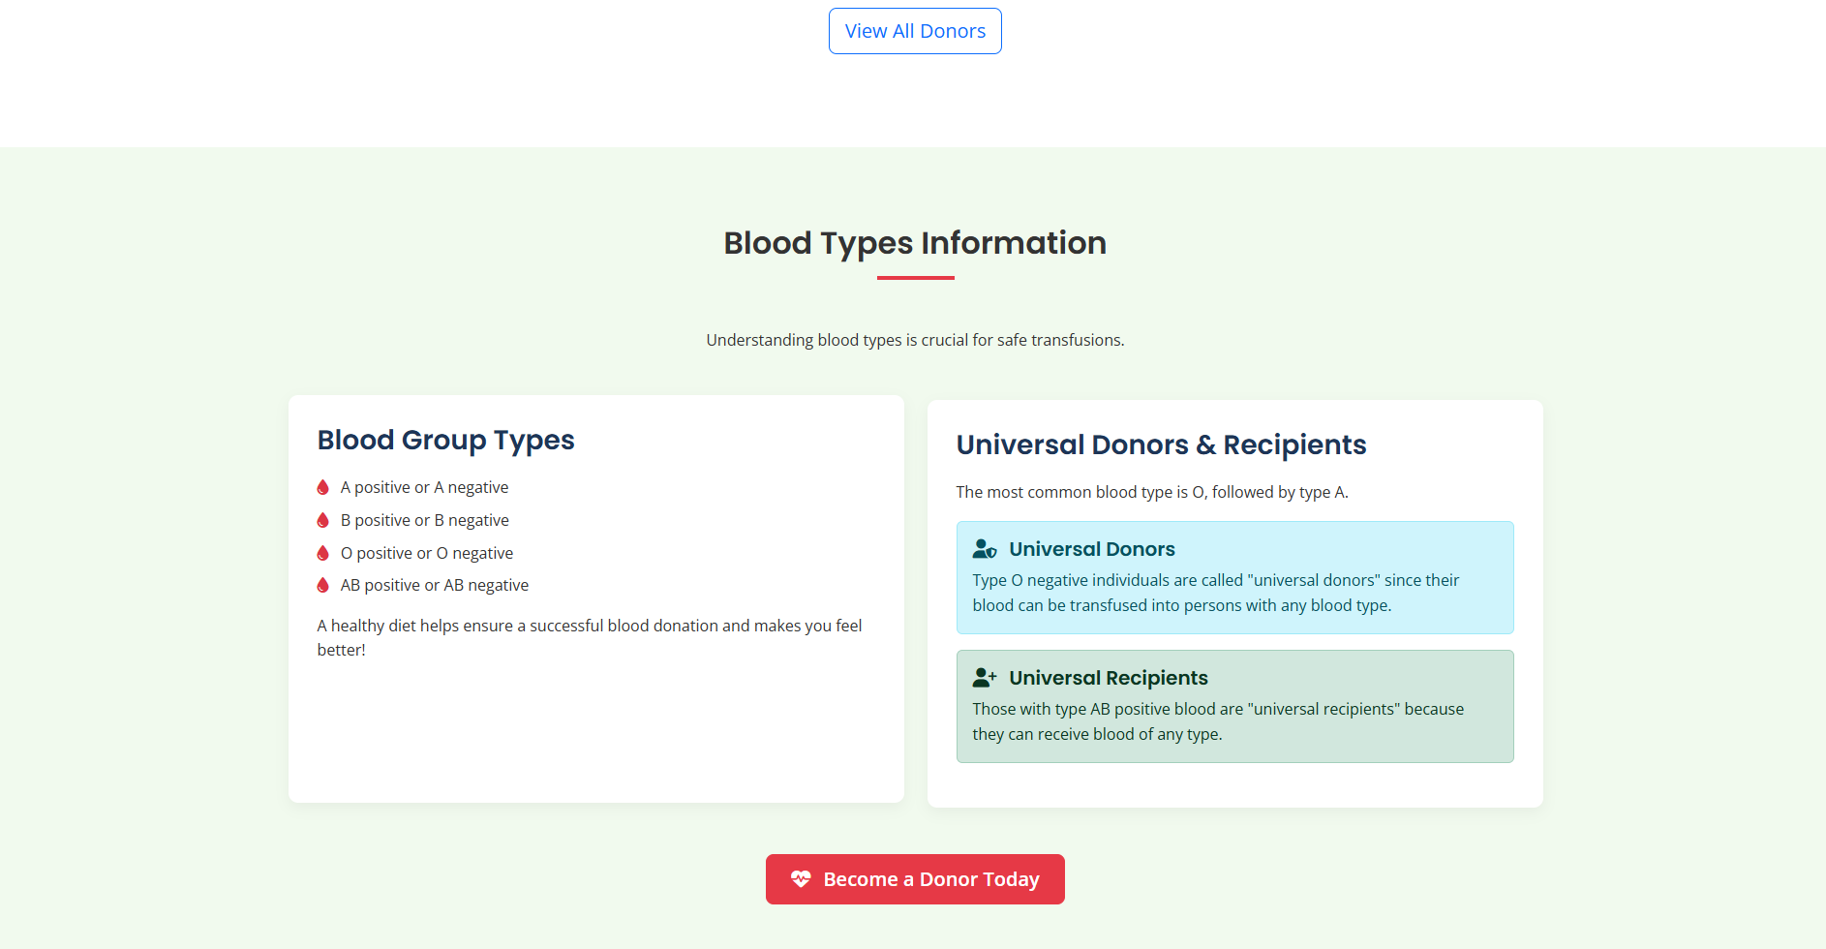
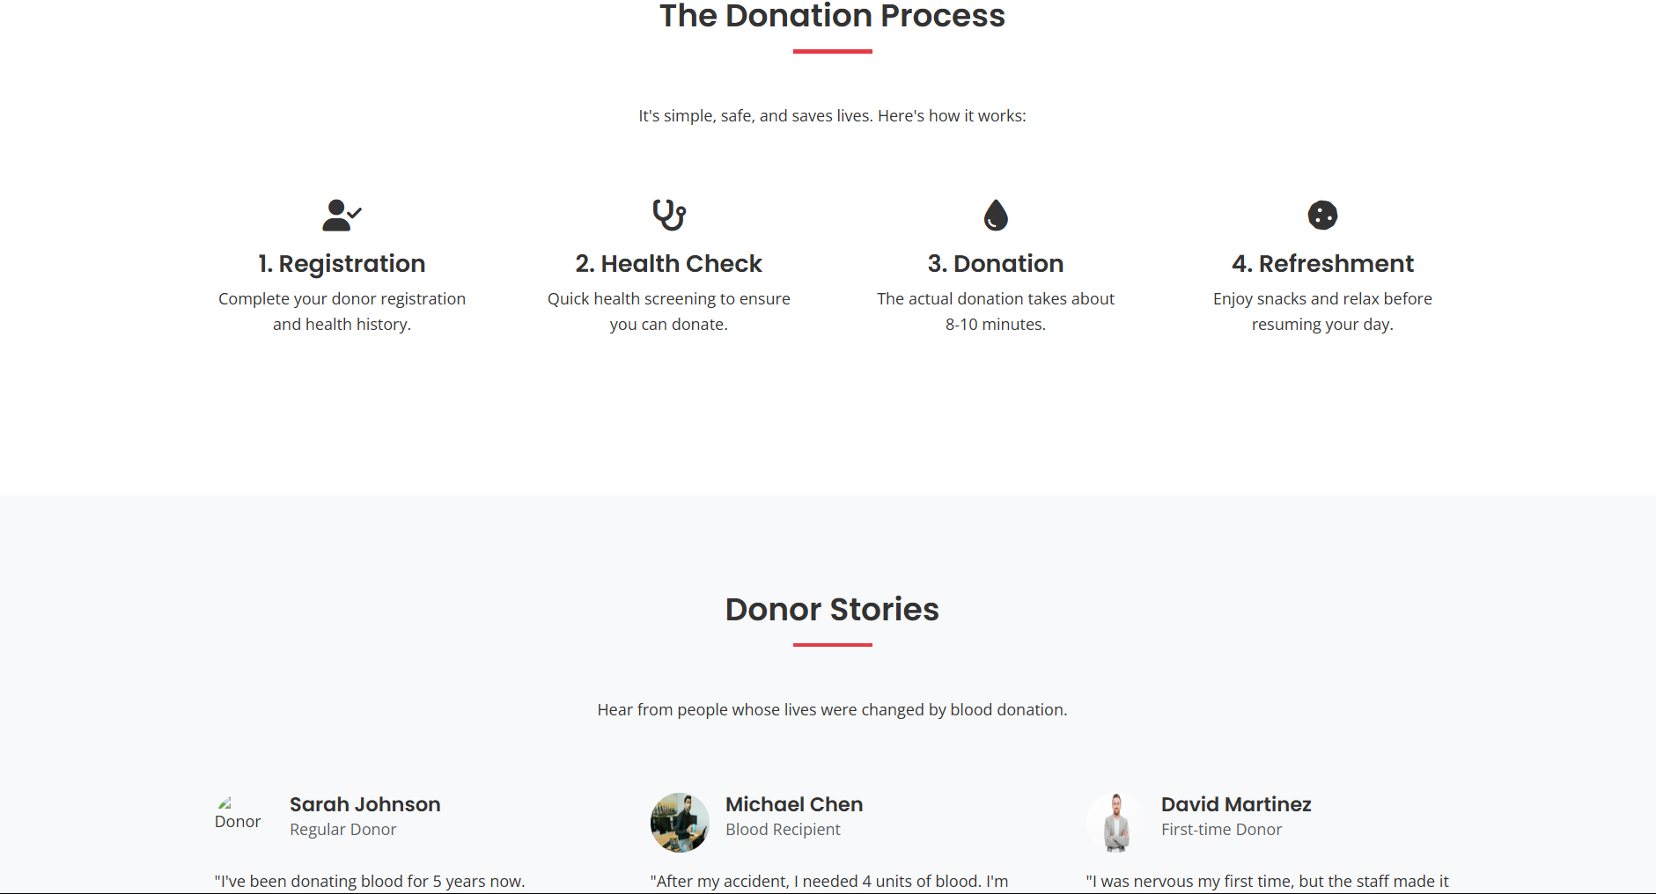
Probable User Interface

Slide 20
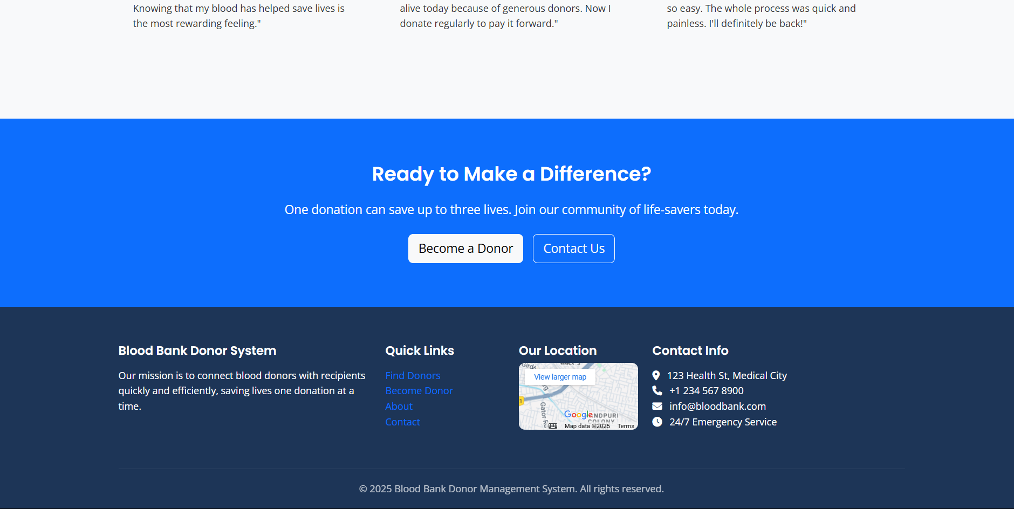
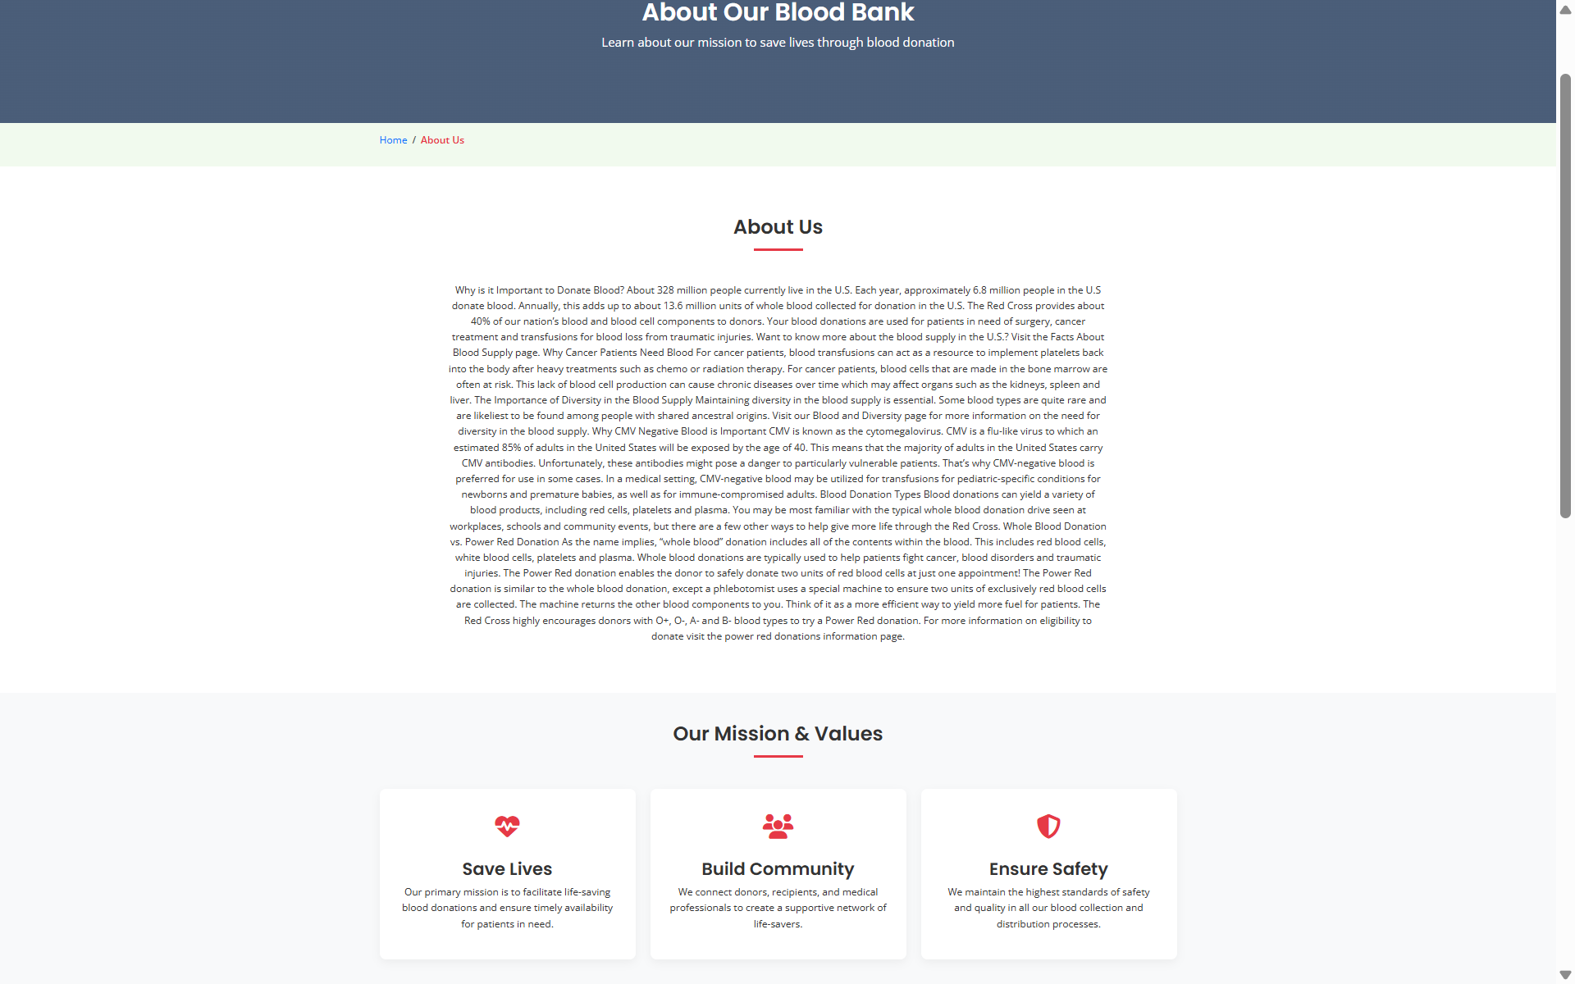
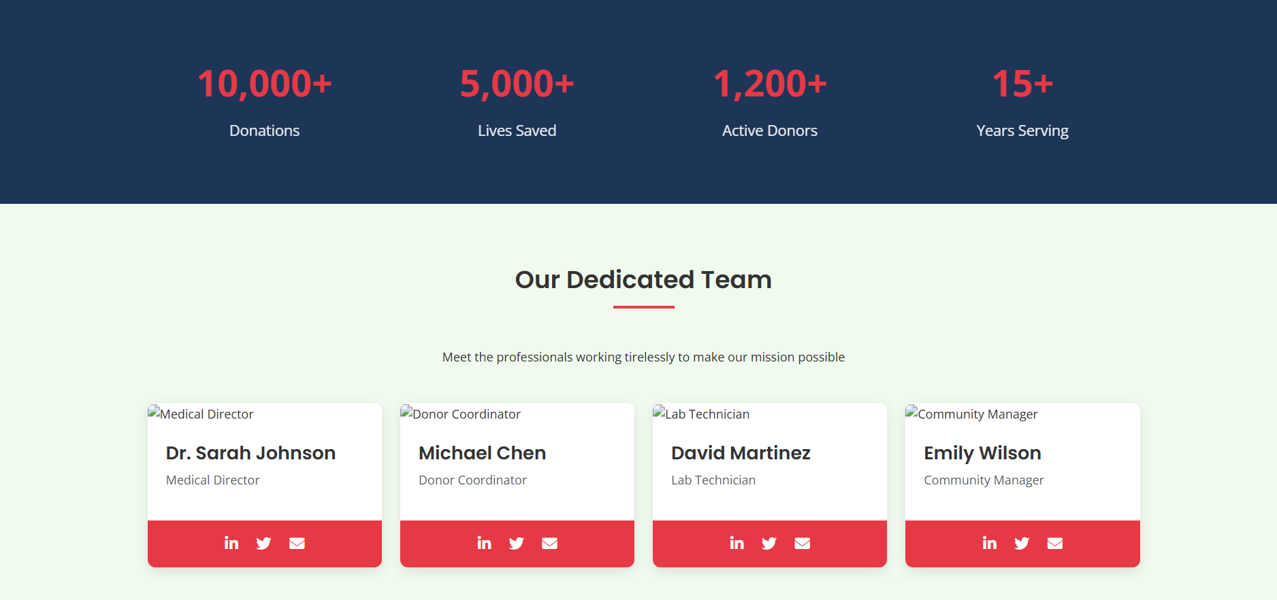
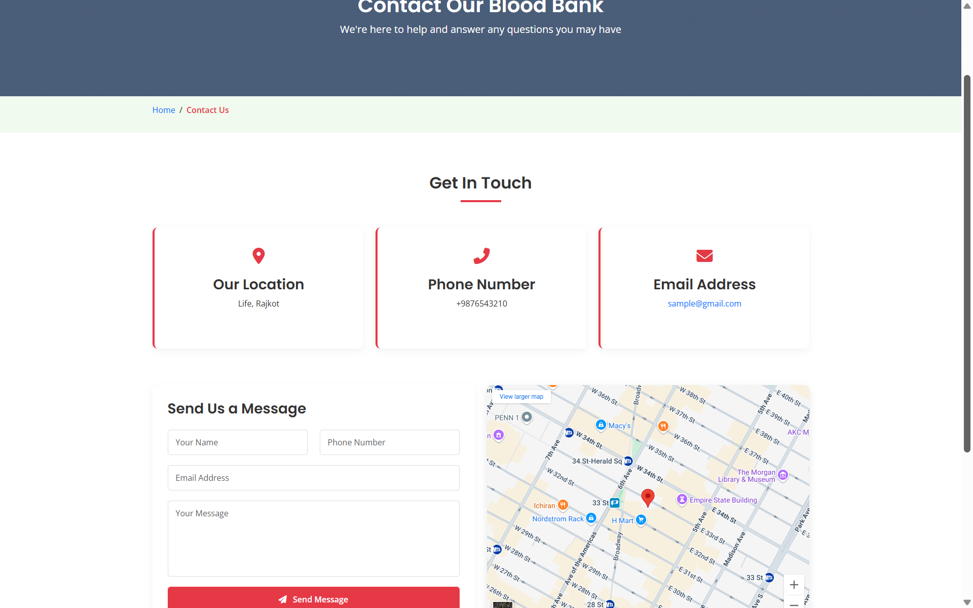
Probable User Interface

Slide 21
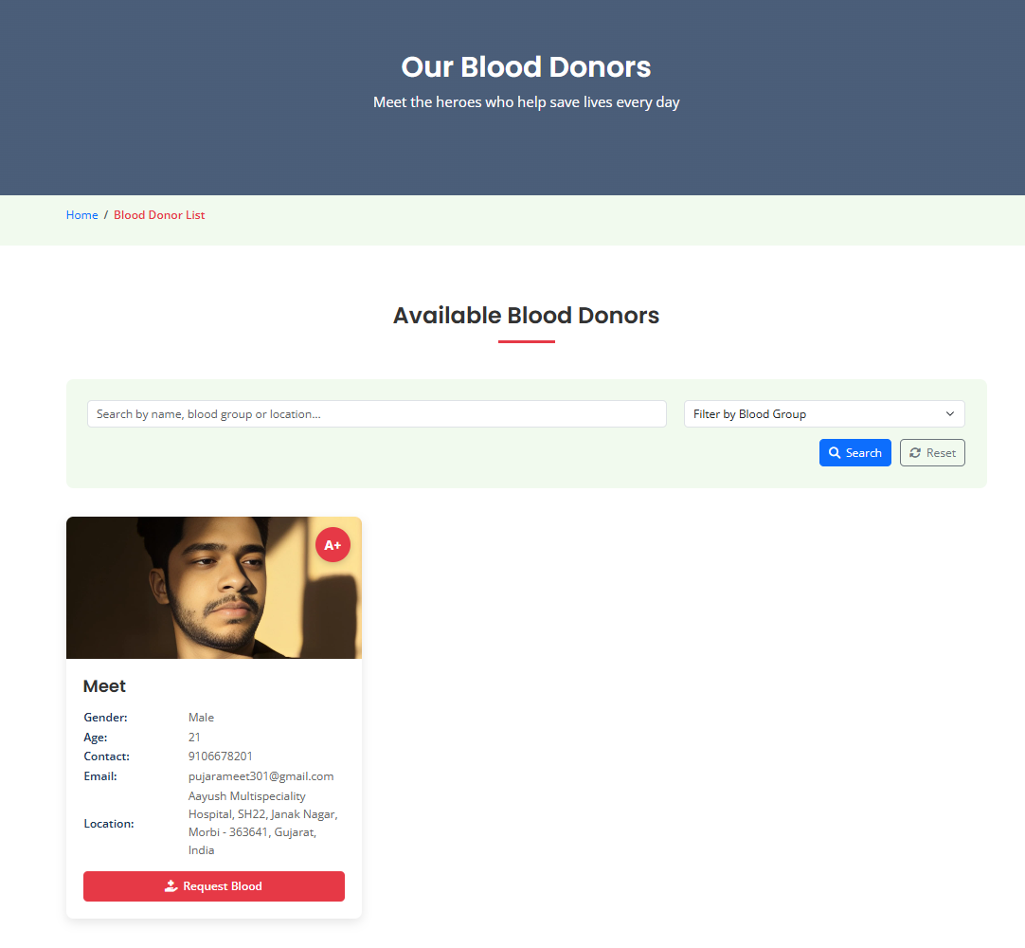
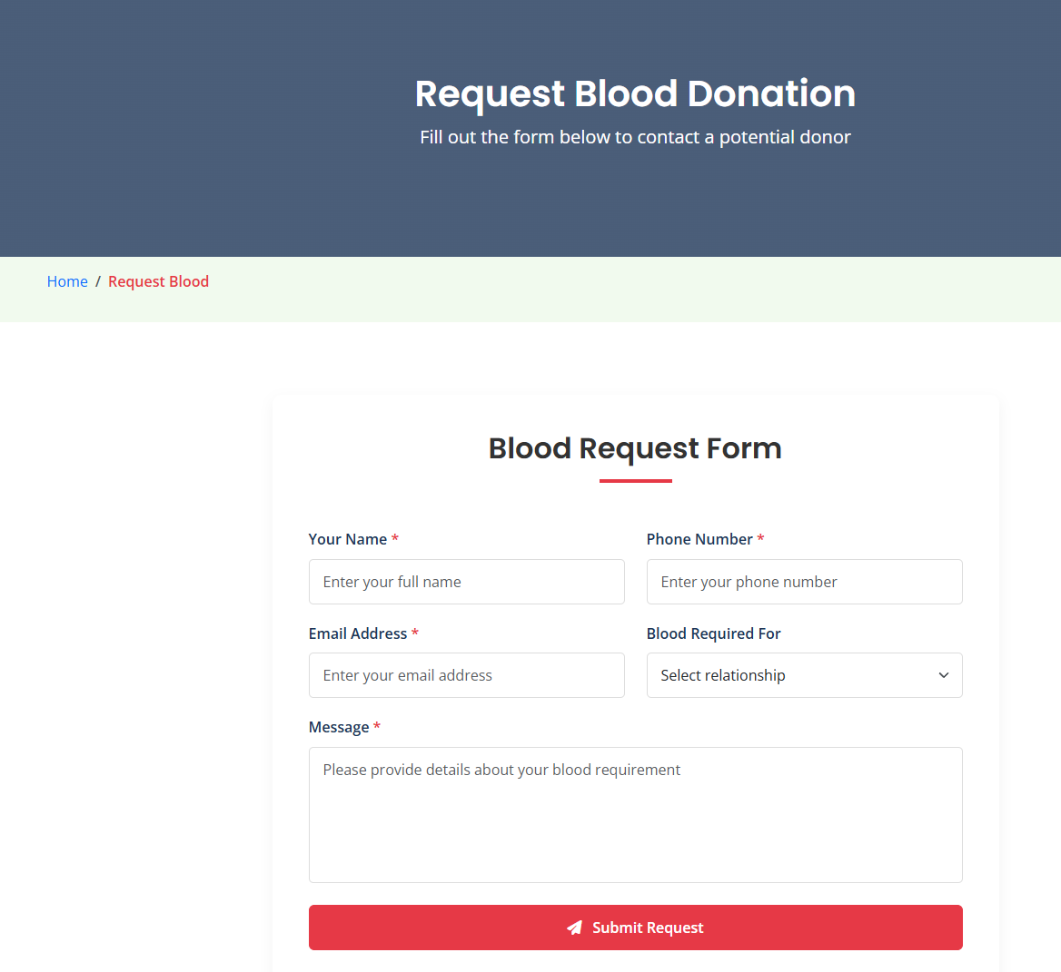
Probable User Interface

Slide 22
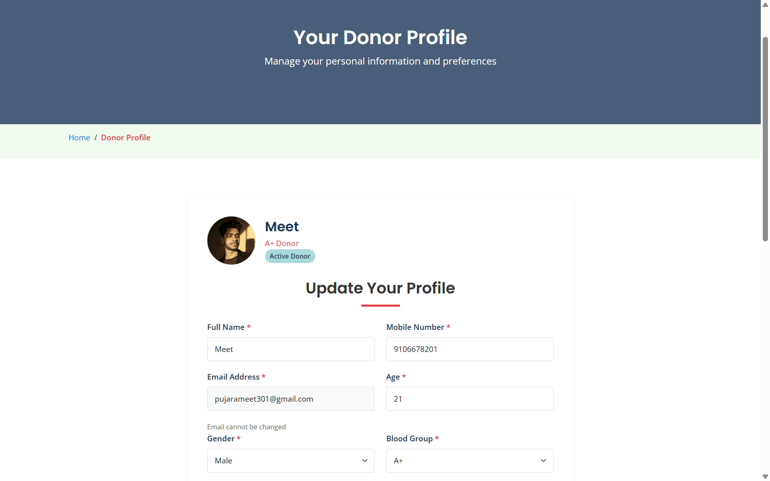
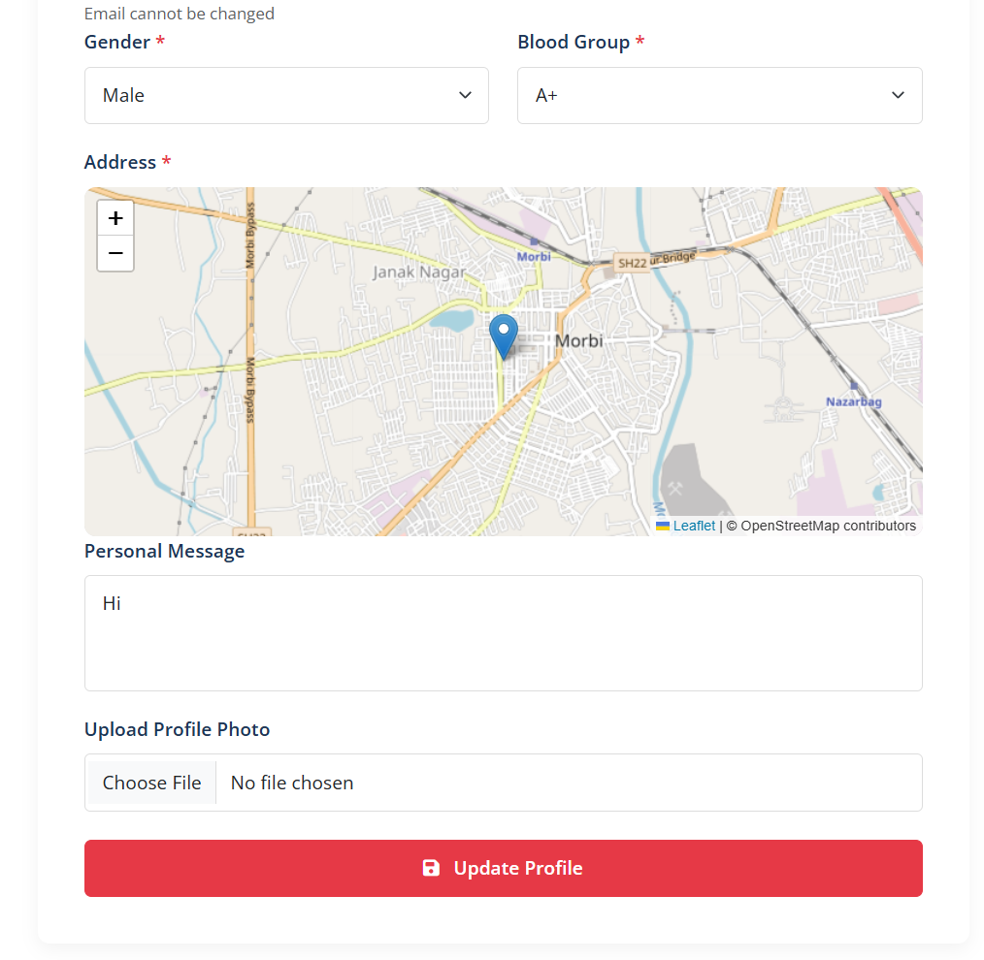
Probable User Interface

Slide 23
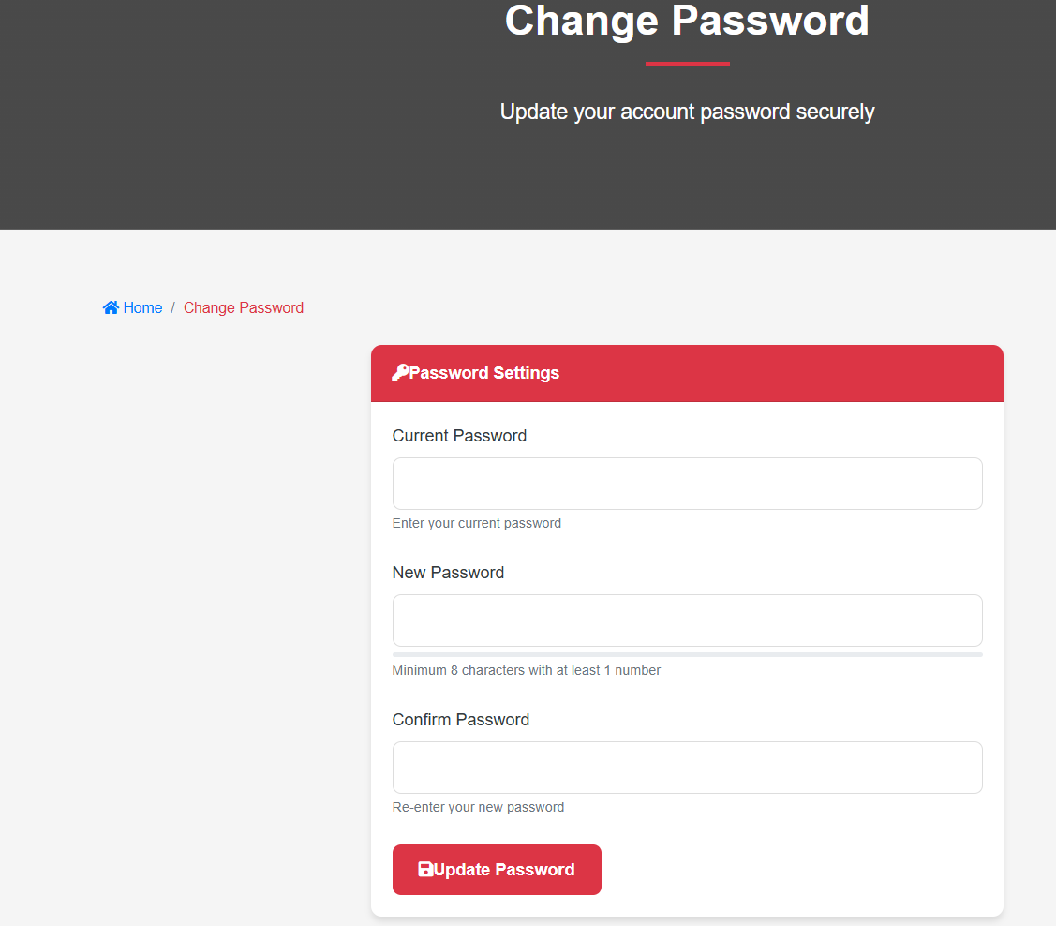
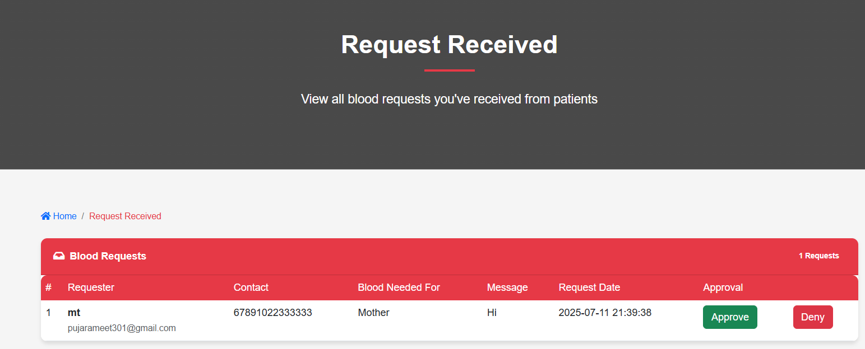
Probable User Interface

Slide 24
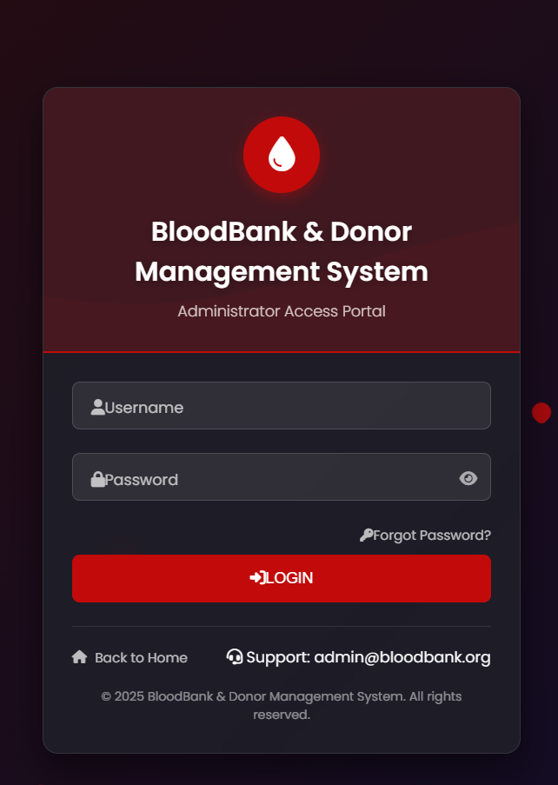
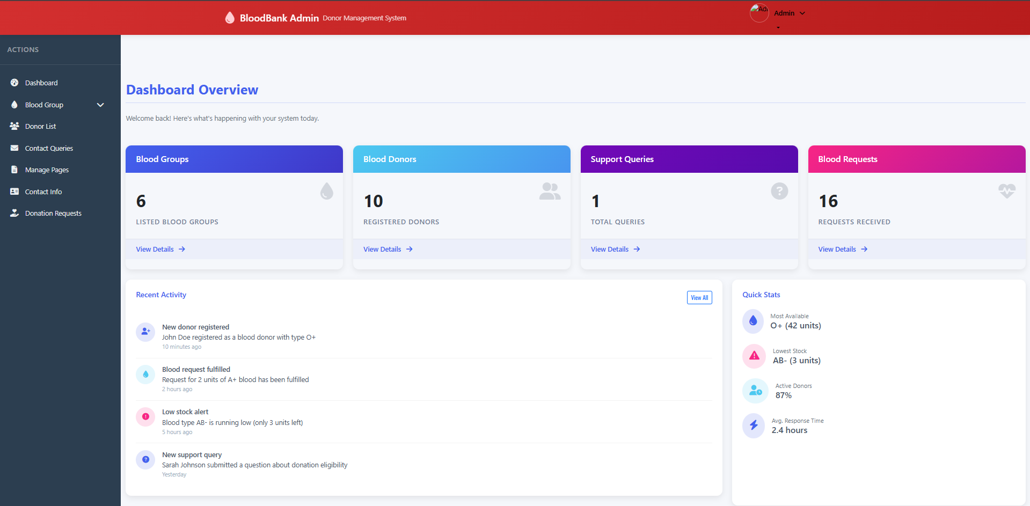
Probable User Interface

Slide 25
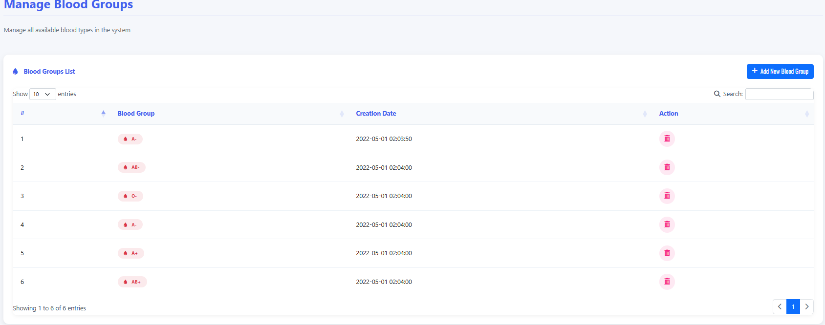
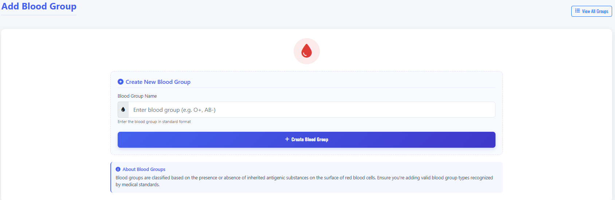
Probable User Interface

Slide 26
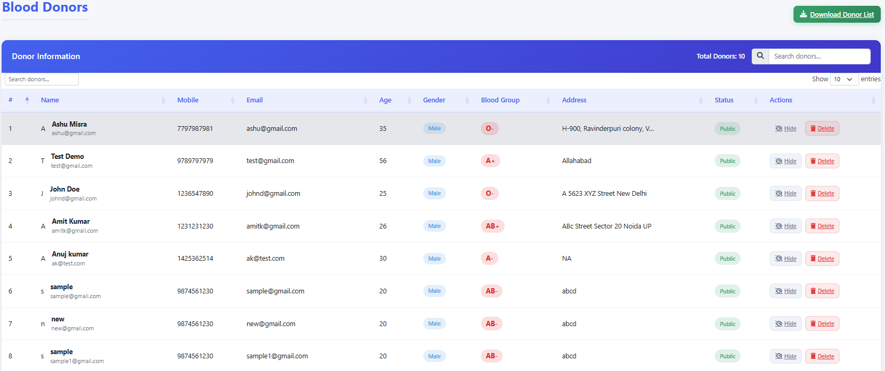
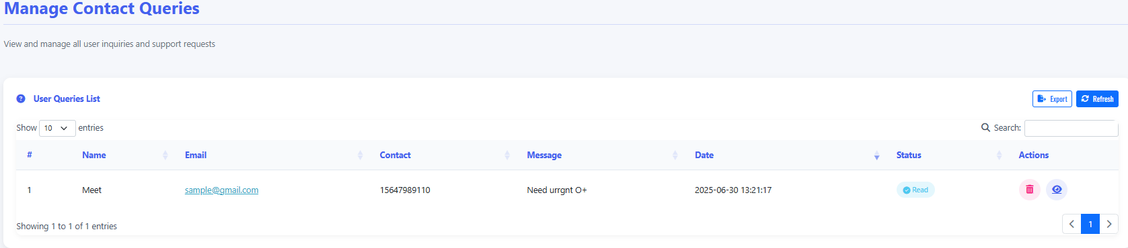
Probable User Interface

Slide 27
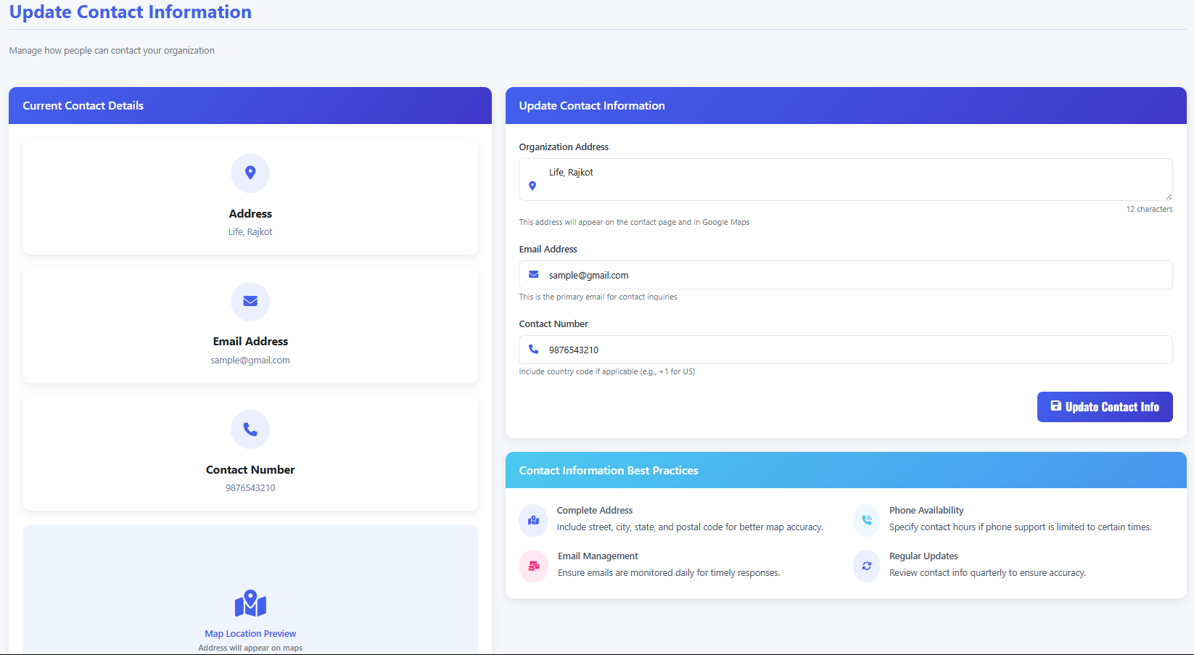
Probable User Interface

Slide 28
Conclusion
The Blood Bank Management System project successfully delivers a comprehensive solution for managing blood donation operations, donor engagement, and inventory control. This system revolutionizes blood bank operations by replacing fragmented processes with an integrated digital ecosystem. By connecting donors, medical staff, and patients through real-time data visibility, it ensures the right blood reaches the right patient at the right time – ultimately saving more lives through technological innovation. The project demonstrates how targeted digital transformation can create tangible humanitarian impact in healthcare infrastructure.

Slide 29
References
1. Healthcare Standards & Regulations
WHO Blood Donor Guidelines (2021): Global standards for donor screening and blood safety.
AABB Technical Manual (2023): Industry best practices for blood bank operations and transfusion protocols.
Council of Europe Guide (2022): Quality assurance frameworks for blood component preparation.
2. Technical Implementation
Database Systems (Elmasri & Navathe, 2021): Foundational ERD design principles.
Azure Health Blueprint: HIPAA-compliant cloud architecture for healthcare data.
3. Security & Ethics
OWASP Top 10 (2023): Critical web application security risks.
NIST Digital Identity Guidelines (2020): Authentication and data protection standards.
UNESCO Bioethics Framework: Ethical guidelines for donor privacy and consent.
4. Operations & Analytics
Pereira (2022): Perishable inventory models for blood shelf-life optimization.
American Red Cross Stats: Real-world blood collection/distribution metrics.
Global Market Report (2023): Industry trends and demand forecasting insights.
5. User Experience
The Design of Everyday Things (Norman): Human-centered design principles.
Healthcare Usability (Nielsen): UX strategies for emergency medical interfaces.

Slide 30


